Slide 1
Statistical and NLP Musical Research Tool
Anna Lucas
COS497 S02 IW: Natural Language Processing
Adviser: Christiane Fellbaum
December 2022

Slide 2
Motivation
Audience: humanities/social science researchers
Some research questions require strong technical background
API details time-consuming and less relevant to them

Slide 3
Goal
Wealth of information for linguistic/music researchers is out there!
Inputs: Spotify and Genius API
Output: Way to explore useful information and summaries of this dataset
Use natural language processing programs to explore correlations
Ex: “Is an acoustic song more likely to have sad lyrical sentiment?”

Slide 4
Related Work
Spotify Database (“Spotify Tracks DB” on Kaggle)
No lyrics or NLP; Less features analyzed
Spotify/Genius Lyrics Code Tutorials (Maaz Khan on Medium)
No actual dataset; no NLP
“NLP of Lyrics” (Madehero 2005)
No metadata to compare against
None of the latest features/datasets

Slide 5
Approach
Novel idea: Combine Spotify, LyricsGenius, NLP…
Wide range of features to compare
Useful independent of the specific question
…and bring instant data visualization to the researcher
Compare 100+ combinations of features
not just “acoustic vs sad lyrics?”

Slide 6
Implementation
Python packages
Song recommendations and metadata: spotipy (Spotify in python)
Lyrics: lyricsgenius
Data wrangling: sqlite3
NLP: nltk among others
Google Drive / Google Colab intermediary step for database hosting*
AnvilWorks free-to-host web app designed in python

Slide 7
Results [Metrics]
Original metrics of success…
>1000 songs ✔️ Currently 5k* with room to expand to ~200k
Fast ✔️ All UX loads meet time limits
Cloud computing or low resource usage ✔️
In hindsight, successful project also needs…
Transparent code - still working
“Free forever” hosting - almost done
Collected So Far:
Songs: 4685
Total tokens: 256905
Unique tokens: 23494
Genres: 86
Dataset Size: 10 MB

Slide 8
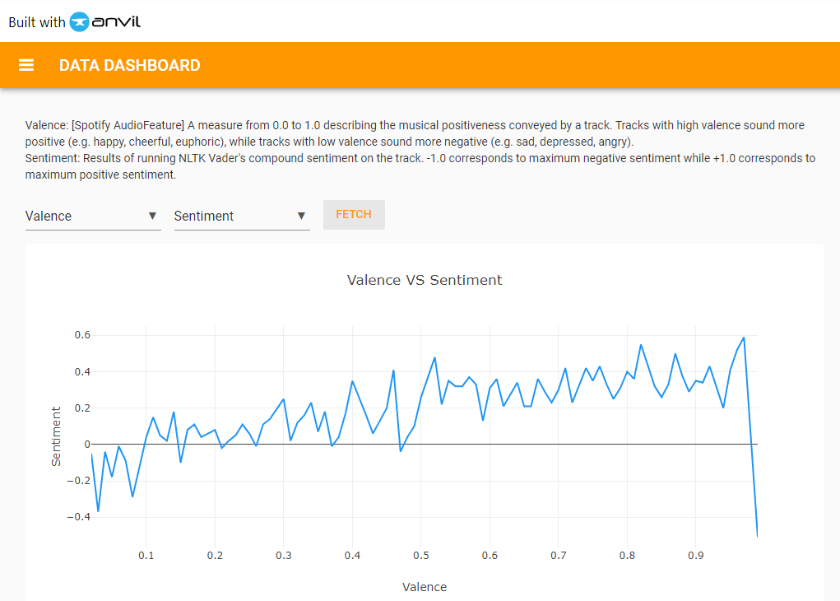
Results [Example 1/3]

Slide 9
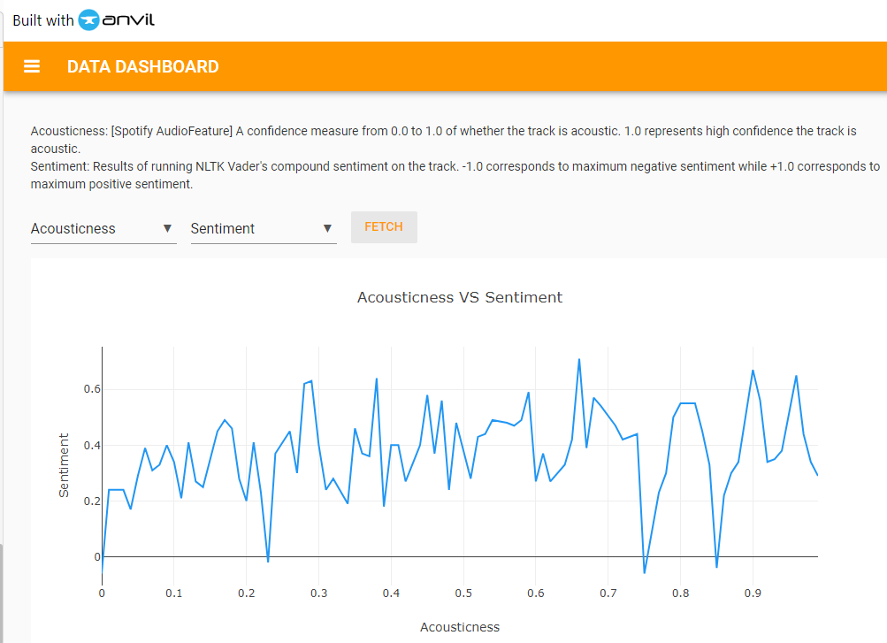
Results [Example 2/3]

Slide 10
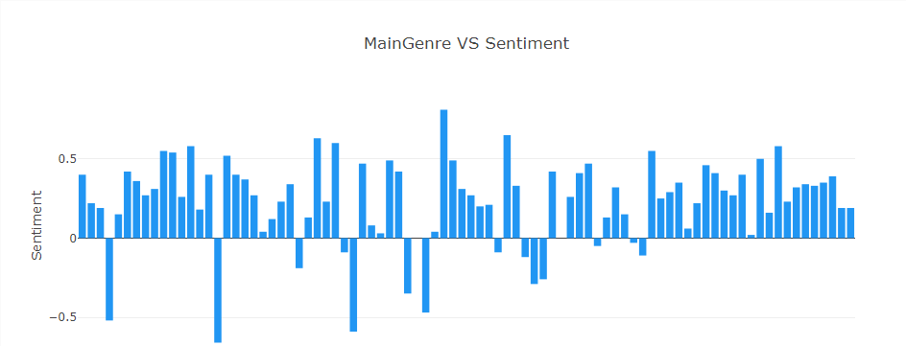
Results [Example 3/3]
Normally explored via mouseover.
Highest positive: holidays, country, gospel, jazz
Highest negative: 6 types of metal, emo, goth

Slide 11
Conclusions
Created a dataset and tool to shortcut lyrical NLP research
Great on numerical metrics, needs more documentation
Some interesting correlations already found

Slide 12
Future Work
Remaining steps this term
Transfer database to Anvil from Colab
Code documentation
Next projects
More features - didn’t get to Topic Modeling
Filters
Long-term effects
Hopefully, inspiration and code help for music + linguistics researchers

Slide 13
Acknowledgements
Thank you to Prof. Fellbaum and my classmates in the seminar!
Related Work Sources
https://www.kaggle.com/datasets/zaheenhamidani/ultimate-spotify-tracks-db
https://www.researchgate.net/profile/Pedro-Cano-12/publication/221573745_Natural_language_processing_of_lyrics/links/00b7d52826f623edfb000000/Natural-language-processing-of-lyrics.pdf
https://medium.com/swlh/how-to-leverage-spotify-api-genius-lyrics-for-data-science-tasks-in-python-c36cdfb55cf3
Extra code reference sources
Documentation for each package/platform
NLP project I did in Introduction to Digital Humanities, Spring 2020

